Slide 1
DATABASE MANAGEMENT SYSTEM
CS23332
EXERCISE 4
WRITING BASIC SQL SELECT STATEMENTS
GANGA GOWRI P
241801070

Slide 2
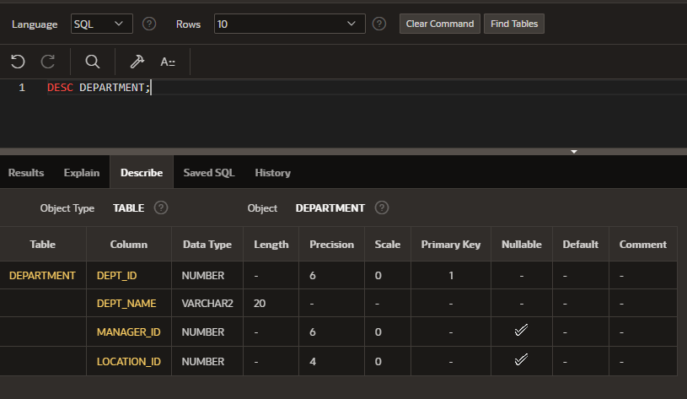
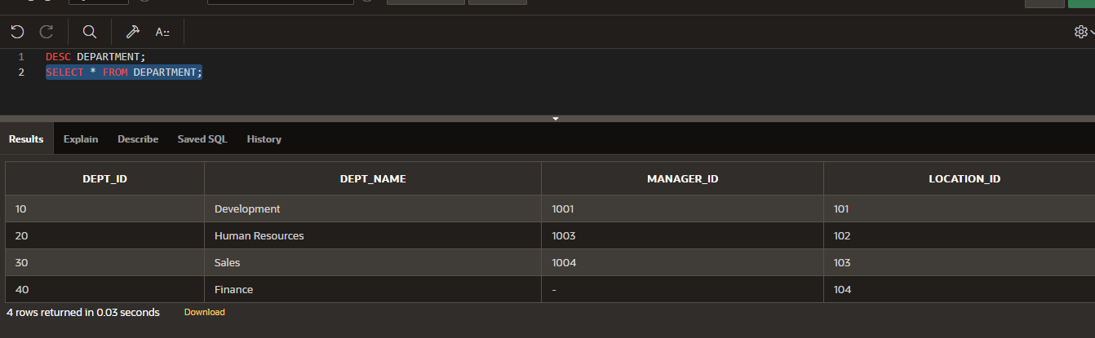
2. Show the structure of departments the table. Select all the data from it.

Slide 3
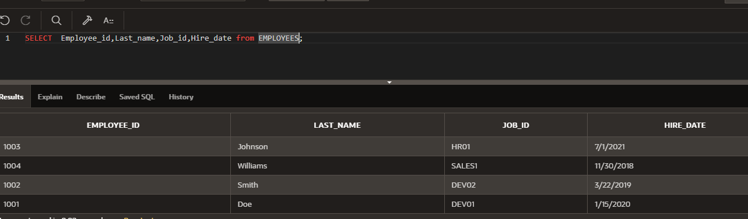
3. Create a query to display the last name, job code, hire date, and employee number for each employee, with employee number appearing first.

Slide 4
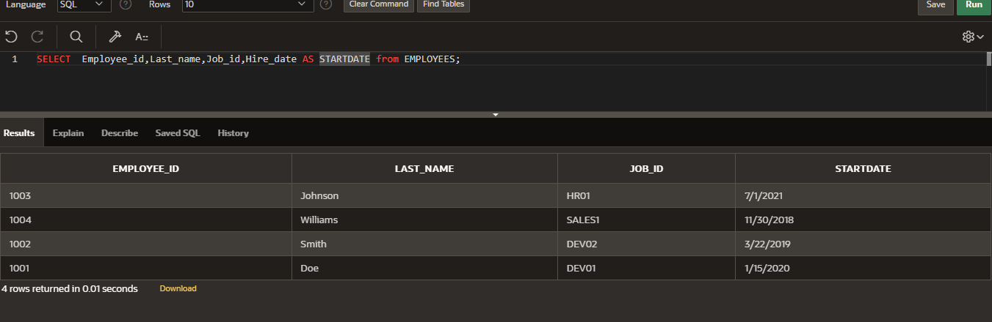
4. Provide an alias STARTDATE for the hire date.

Slide 5
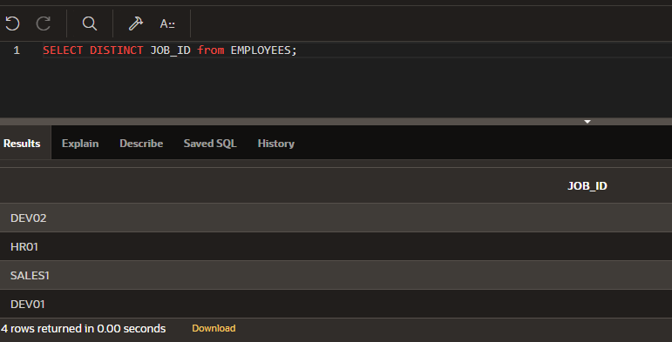
5. Create a query to display unique job codes from the employee table.

Slide 6
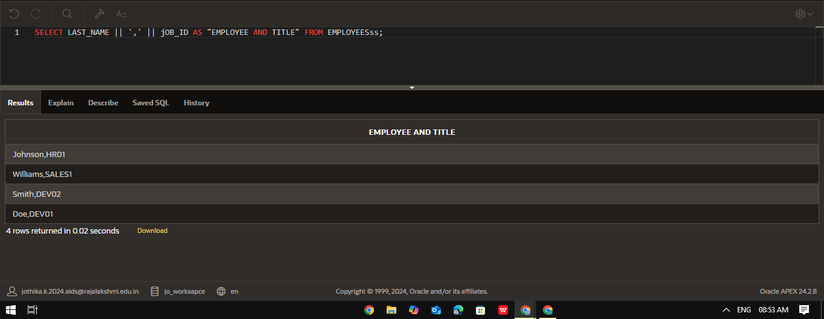
6. Display the last name concatenated with the job ID , separated by a comma and space, and name the column EMPLOYEE and TITLE.

Slide 7
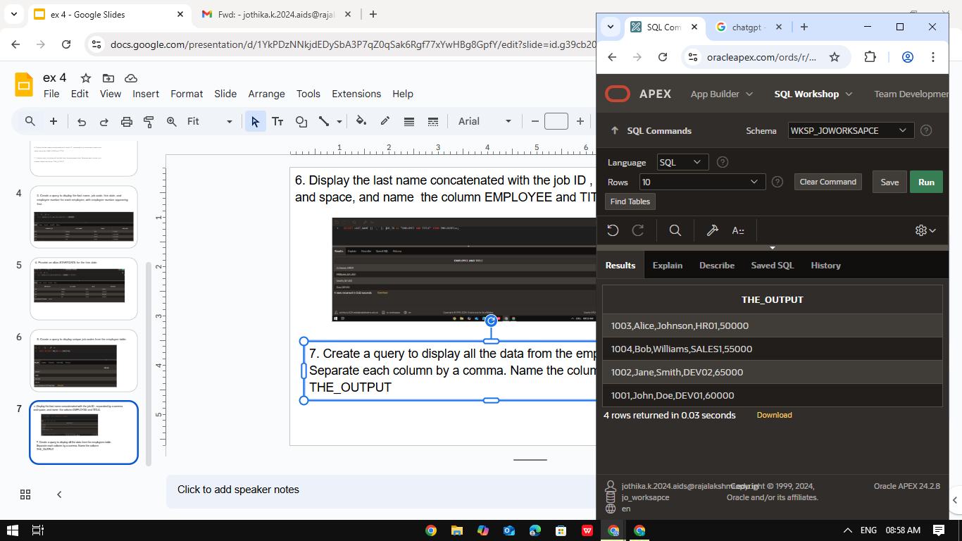
7. Create a query to display all the data from the employees table. Separate each column by a comma. Name the column THE_OUTPUT

